Slide 1

MPOWER: measures to reduce tobacco use worldwide
Marco Colangelo 67045A
Pablo Fabricio Aguirre Guaman 67074A

Slide 2
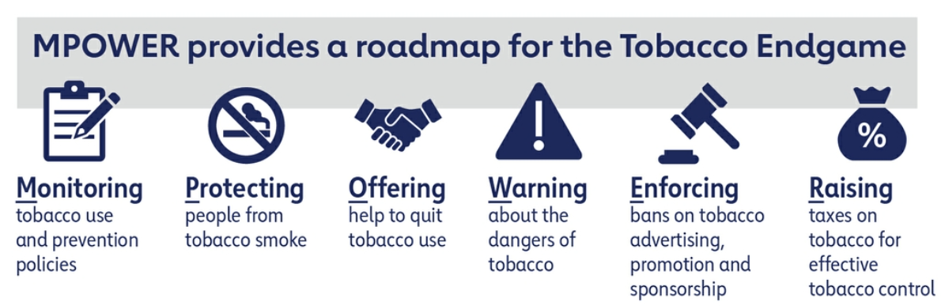

What is MPOWER?
MPOWER is a set of tobacco control measures developed by the World Health Organization (WHO) in 2004 to help countries reduce tobacco use, following the articles of the WHO Framework Convention on Tobacco Control.

Slide 3
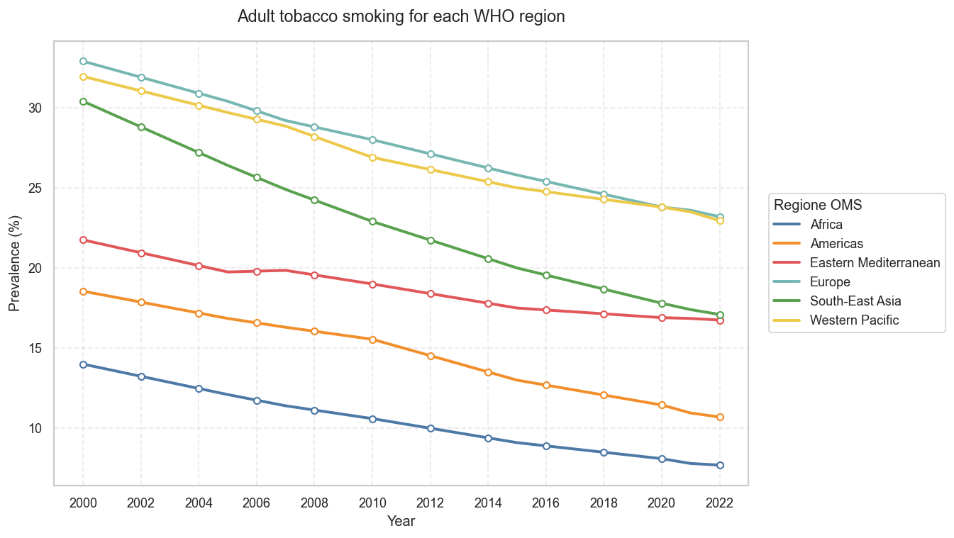
Monitoring: Considering the adult population (for which more data are available), how has the percentage of smokers changed over the years?
Most important thing: a global decreasing trent among adults
South-East Asia: from 30% to 17%
Europe: from 33% to 23%
Western Pacific: from 32% to 23%
Americas: from 18.5% to 10.5%
Africa: from -14% to -7.5%
Eastern Mediterranean: from 21.5% to 16.8%

Slide 4
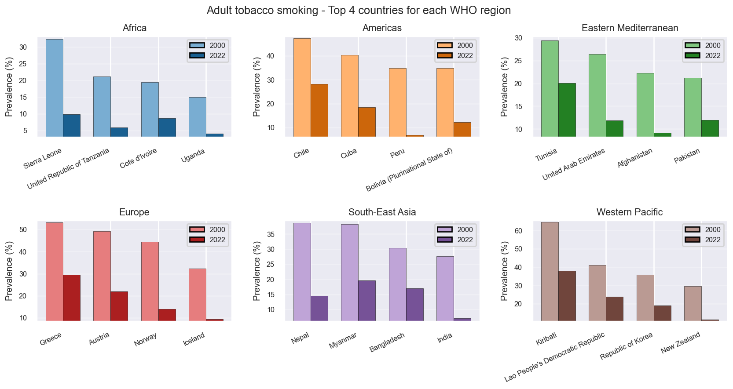
Monitoring: Considering the four countries with the highest percentage of adult smokers in the early 2000s for each WHO region, have they improved? And by how much?
Africa: robust reductions and already low 2022 levels
Americas: significant improvements. Peru and Cuba stand out
Eastern Mediterranean: Decreases present but more moderate. Tunisia and Pakistan stand out.
Europe: Large reductions from historically very high values. Greece, Norway and Iceland stand out.
Southeast Asia: Sharp declines. India, Bangladesh and Myanmar stand out.
Western Pacific: Improvements but with very high departures; Kiribati and New Zealand stand out.

Slide 5
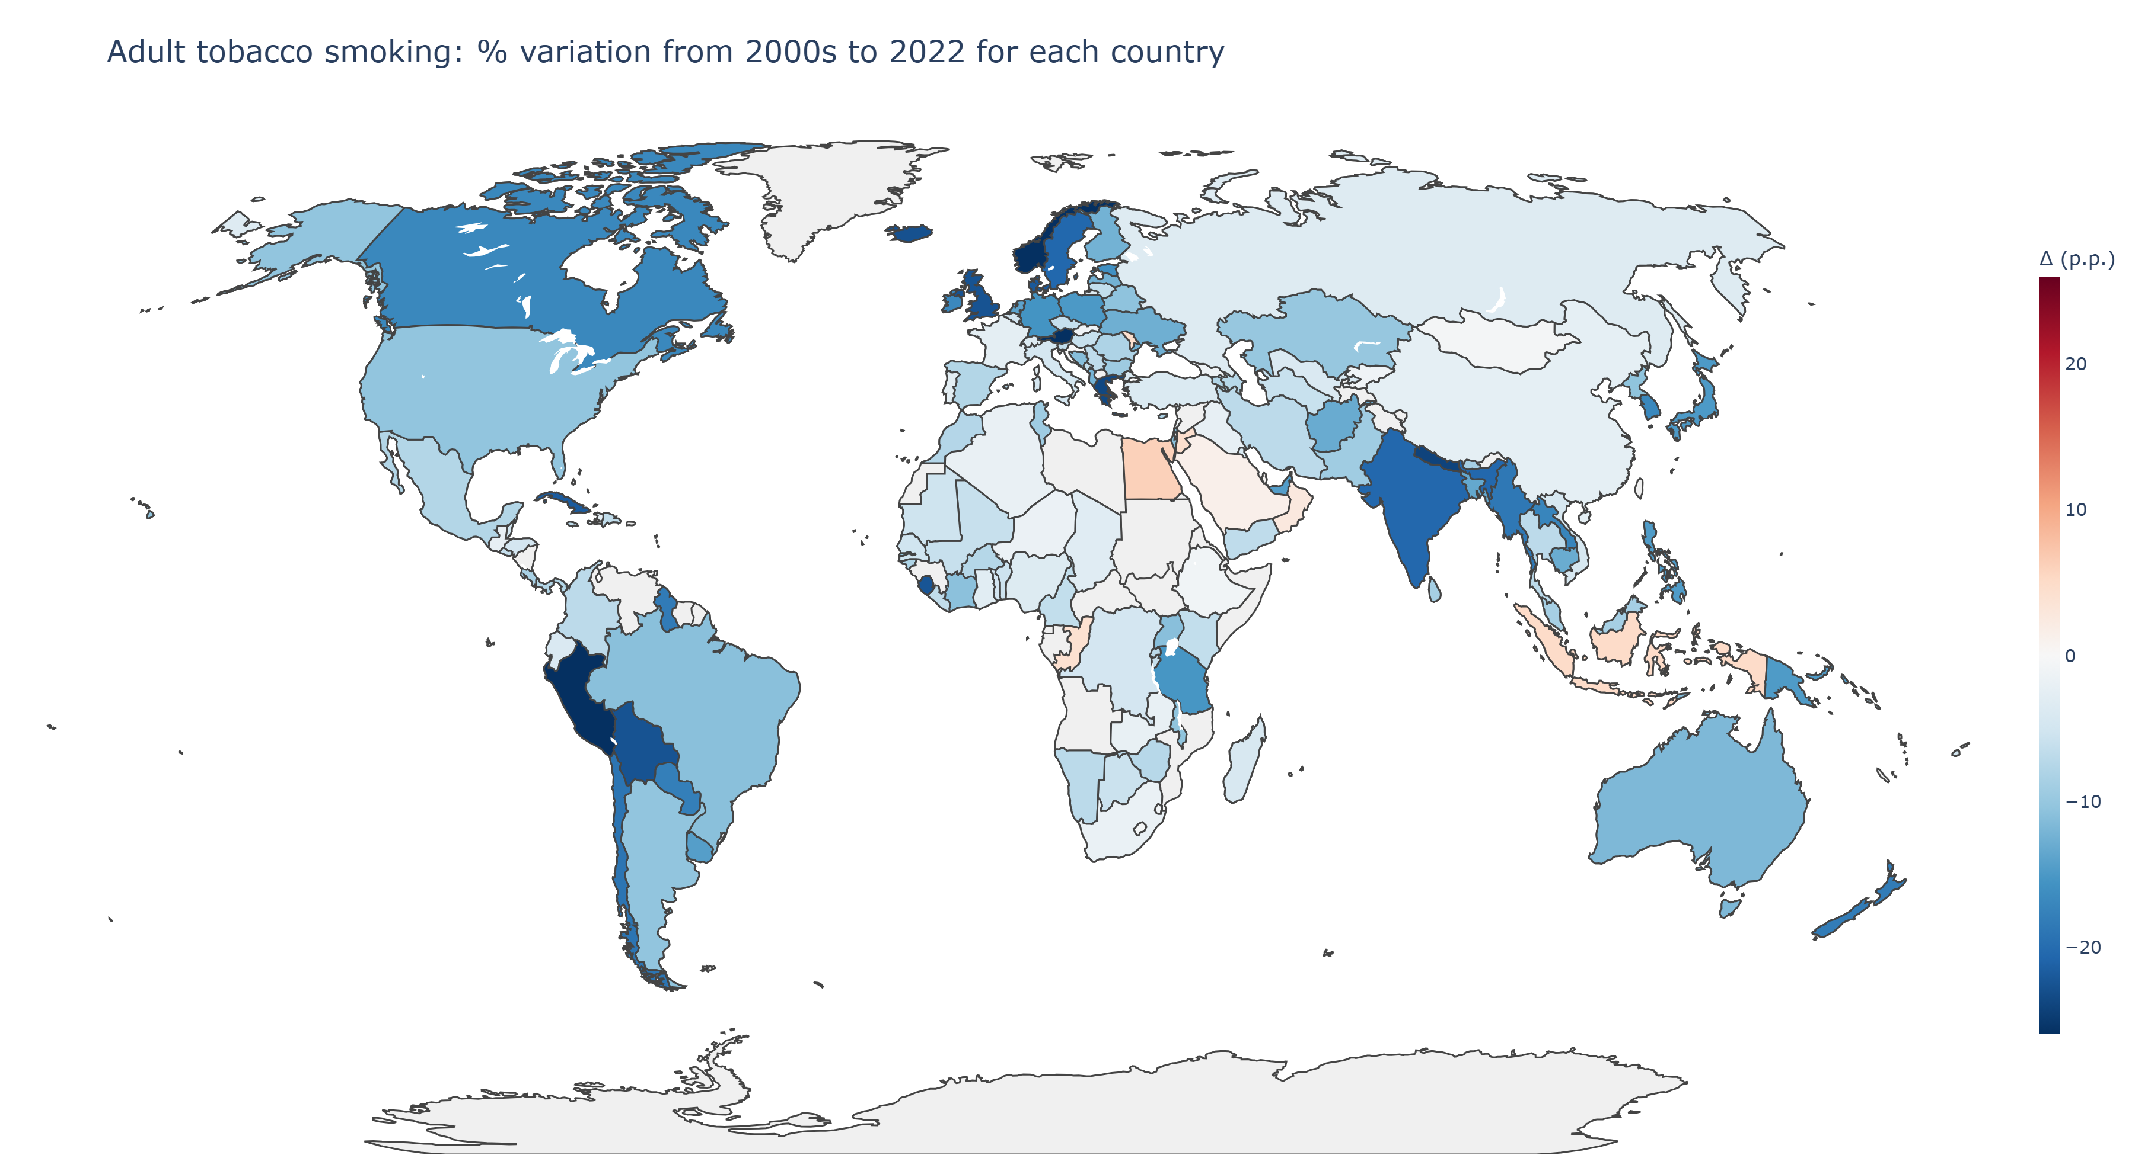
Monitoring: recalling the previous graph, how has the world's adult population improved in recent years?
Europe: strong reduction but still not low levels
South-East Asia: great proress driven by large countries
Western Pacific: heterogeneous reductions
Eastern Mediterranean: slower improvements
Africa: moderate improvements
Americas: prevalence of consistent improvements

Slide 6
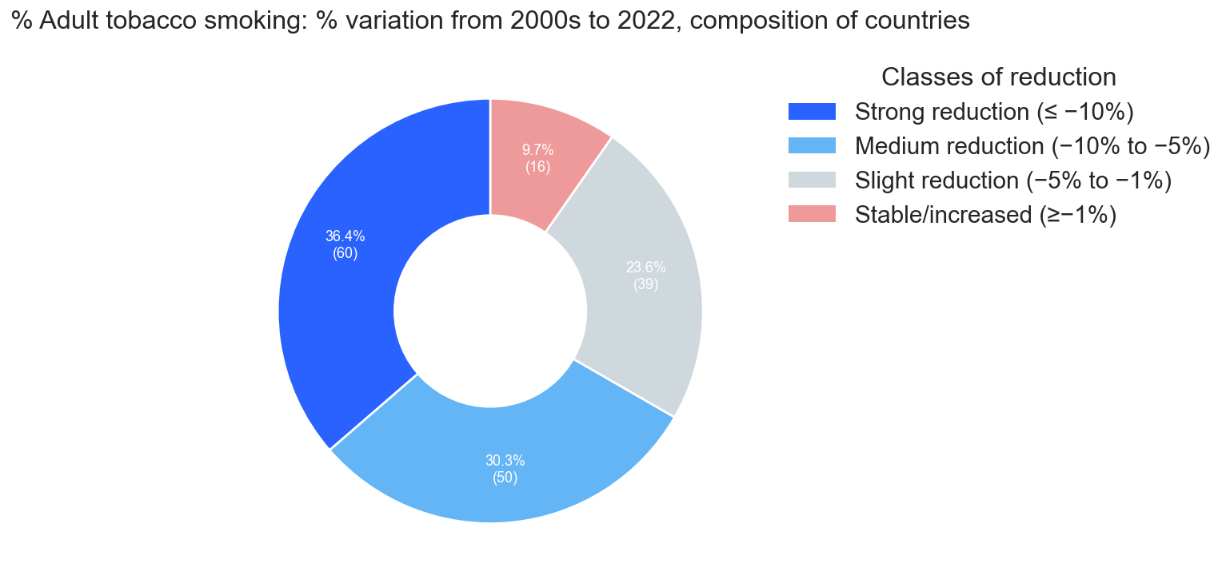
Monitoring: recalling the previous graph, how has the world's adult population improved in recent years?
This graph is complementary to the map of the world seen before.
Each sector represents the fraction of countries that have had a given reduction in the number of adult smokers over the last 20 years.
We can see that about the 90% of countries had an improvement.

Slide 7
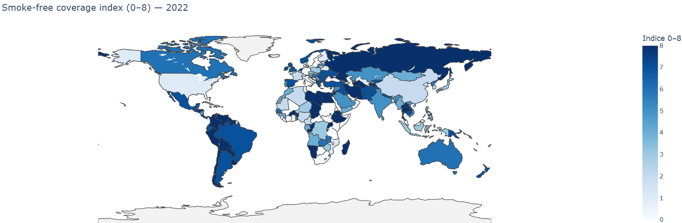
Protection: In how many public places will various countries impose smoke-free regulations in 2022?
The coverage index ranges from 0 to 8 and indicates how many public places a country mandates smoke-free living.
The 8 places are: education places, government places, healthcare places, indoor offices, other indoor public spaces, public transportation, pubs/bars/cafés, and restaurants.
By 2022, the world has come a long way towards smoke-free indoor environments, with areas of high coverage in Europe and the Americas, but persistent gaps remain in several areas of Africa, the Middle East and parts of Asia.

Slide 8
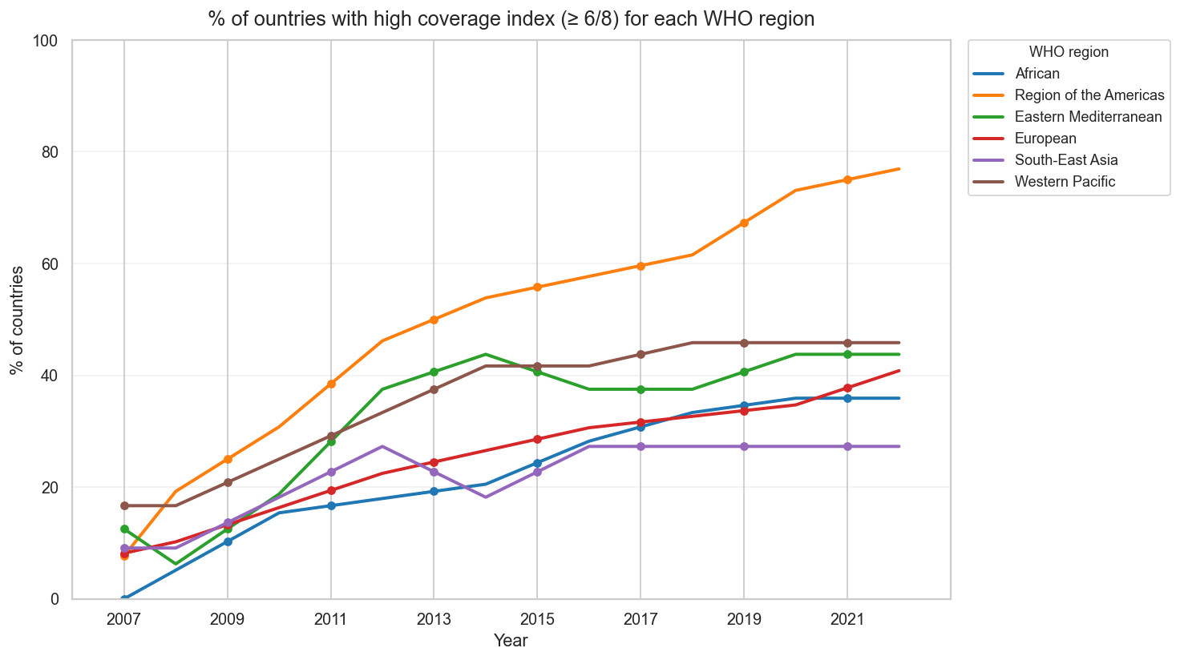
Protection: how much countries with a high coverage index have increased over the years?
Americas: nearly linear growth from ~10% to 75–77% of countries in 2022. This is the region with the highest smoke-free places (≥6/8).
Western Pacific: steady rise to ~45–46% and stable since 2018: a sign of stabilization of the most recent reforms.
Europe: steady increase to ~40% in 2022; continuous but uneven progress across countries.
Eastern Mediterranean: rapid growth until 2013–15 (~40–44%) then stagnation around 40%.
Africa: from almost 0 in 2007 to ~35–36% in 2022; it can improve
Southeast Asia: growth to ~27–28% and then stable since 2016; slower progress.

Slide 9
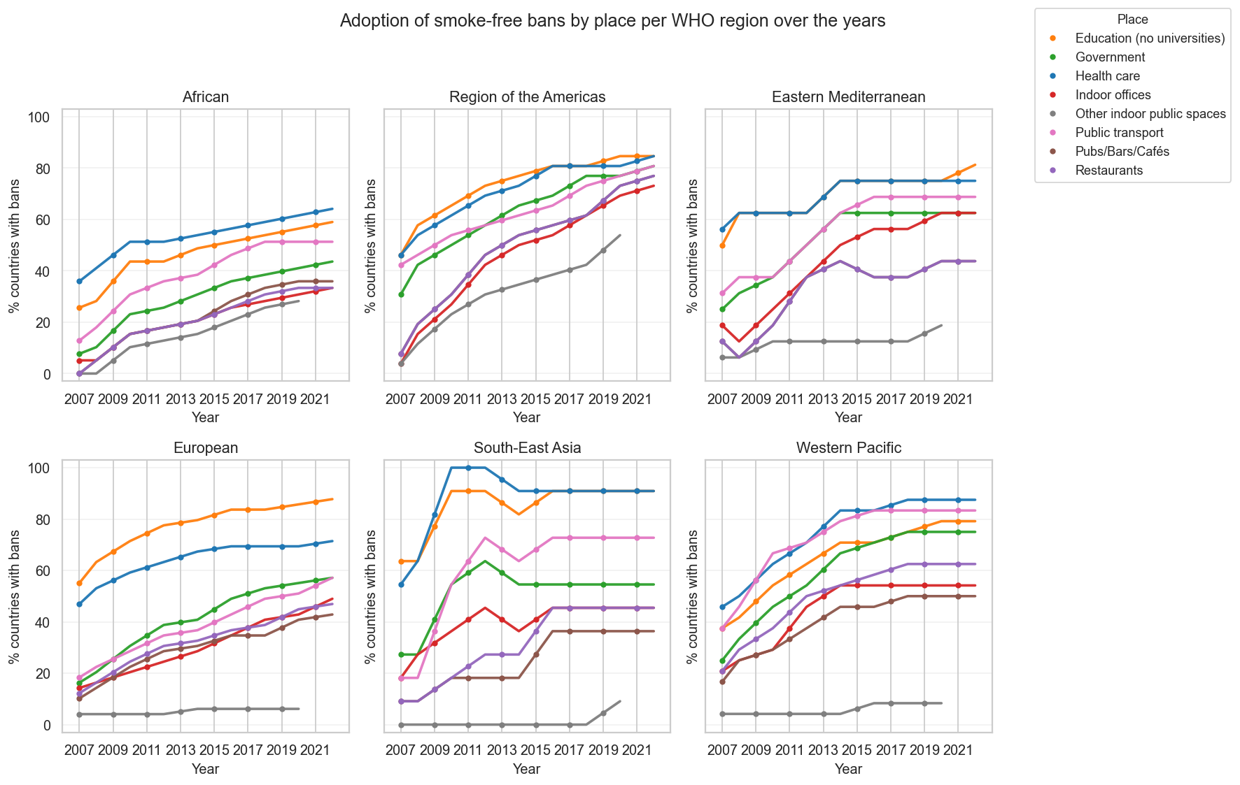
Protection: how much places in WHO regions increased the smoke-free bans over the years?
Americas: nearly linear growth from ~10% to 75–77% of countries in 2022. This is the region with the highest smoke-free places (≥6/8).
Western Pacific: steady rise to ~45–46% and stable since 2018: a sign of stabilization of the most recent reforms.
Europe: steady increase to ~40% in 2022; continuous but uneven progress across countries.
Eastern Mediterranean: rapid growth until 2013–15 (~40–44%) then stagnation around 40%.
Africa: from almost 0 in 2007 to ~35–36% in 2022; it can improve
Southeast Asia: growth to ~27–28% and then stable since 2016; slower progress.

Slide 10
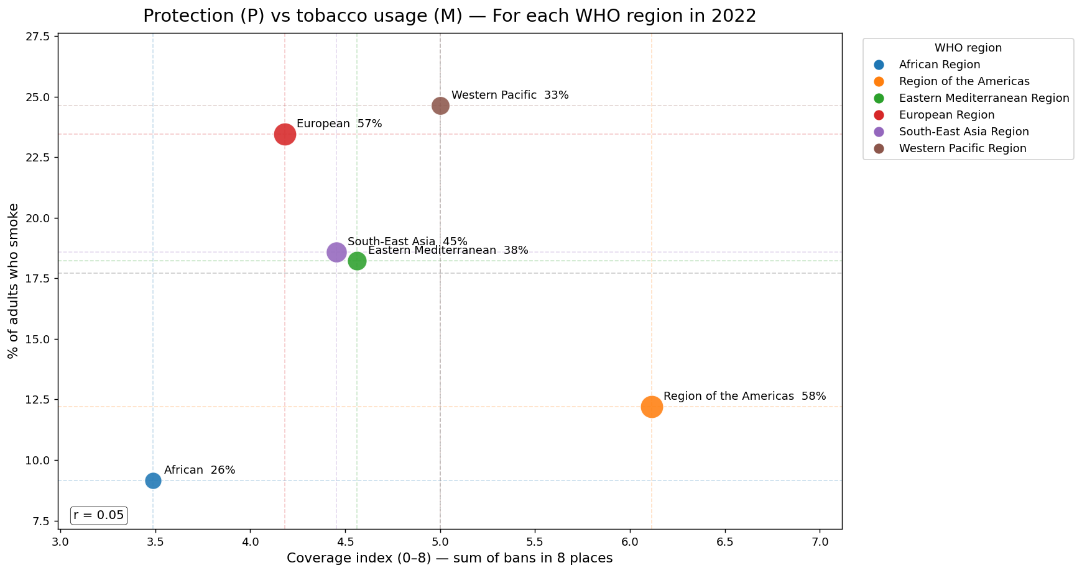
Protection: by 2022, which are the regions where citizens are most "rebellious" towards smoke-free bans?
Americas: highest complaint rate (~58%).Widespread complaints suggest greater activation of reporting/enforcement mechanisms.
Europe: high complaints (~57%). Here, historically high levels of smoking and the demographic/cultural structure keep M at high values ​​despite the adoption of many measures and a good level of reporting.
Western Pacific: complaints ~33%. Probable impact of the very high male prevalence in several countries in the region; less widespread complaints may indicate less widespread or less documented enforcement mechanisms.
Eastern Mediterranean and Southeast Asia: medium complaints (≈38–45%). A "middle of the road": intermediate coverage and intermediate outcomes.
Africa: complaints ~26%. May reflect an earlier phase of the tobacco epidemic, socioeconomic differences, or underactivation of complaint/monitoring systems;
The x axis is the coverage index (0-8)
The y axis is the % of adults within a WHO region who smoke
Each dot represents the level of “rebellion” against smoke-free bans

Slide 11
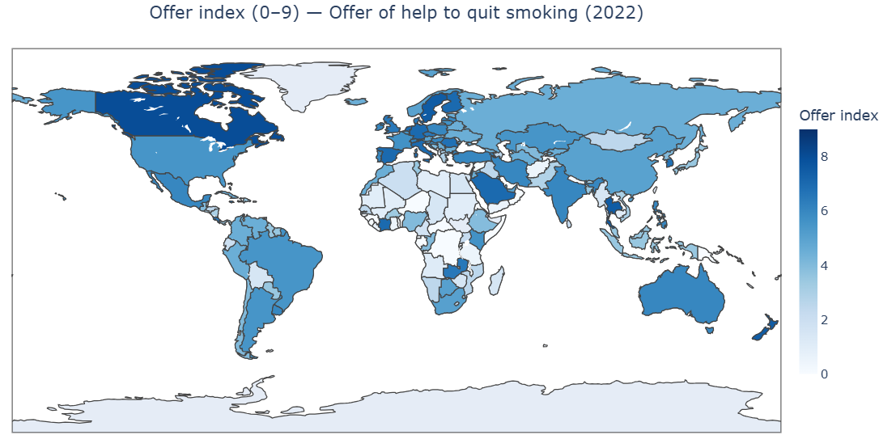
Offering: amount of smoking cessation assistance offered by countries in 2022
The index ranges from 0 to 9 and is the sum of 9 binary components (Yes/No) of the cessation offer:
1 active national quitline;
4 settings with quit support: primary care, hospitals, communities, other settings;
4 medications legally available: NRT, bupropion, **varenicline**, cytisine.
High alues ​​(7–9/9) in North America, Australia/New Zealand, and much of Western and Nordic Europe: systems typically offer multiple settings and multiple medications.
Medium values ​​(4–6/9) in many parts of Latin America and Eastern Europe: quitlines and some settings are often present, but one or two medications or one setting is missing.
Low values ​​(0–3/9) in large areas of sub-Saharan Africa and parts of the Middle East/Asia: typically, no registered medications (NRT or unavailable drugs) and poor coverage in settings.

Slide 12
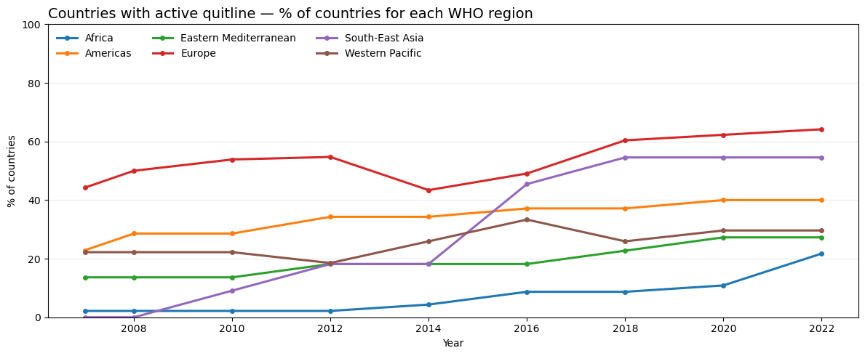
Offering: countries with an active quitline over the years
Quitline: national anti-smoking telephone line (toll-free number) provided by MPOWER
Global trend is increasing: more countries have a quitline than in 2007.
Europe is consistently the highest (≈45% → ≈64% in 2022).
The Americas rise to ≈40% and then flatten.
Southeast Asia jumps between 2014 and 2018 to ≈55% and then stabilizes.
Western Pacific rises to ~33–34% and then fluctuates/stagnates.
Eastern Mediterranean grows slowly (≈14% → ≈27–28%).
Africa remains low but improves (≈2% → ≈22% in 2022).

Slide 13
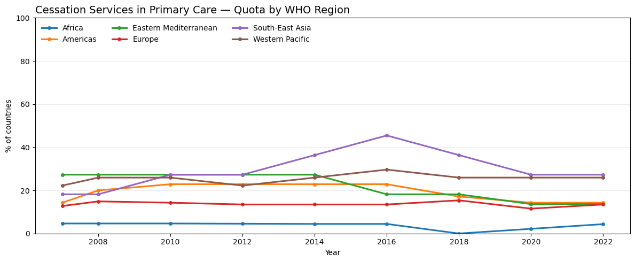
Offering: regions where cessation support is available in most primary care settings over the years
Levels are much lower than quitlines, a sign that integrating cessation into the territory is more difficult.
Southeast Asia was the highest (peaking at ≈46% in 2016), then declined and stabilized at ≈27%.
Western Pacific remains medium and stable (~26–27%).
Americas and Europe are low and flat (~14–24% → ~14–15% in 2022).
Eastern Mediterranean is declining (≈27% → ≈14%).
Africa remains very low (≈3–5%).

Slide 14
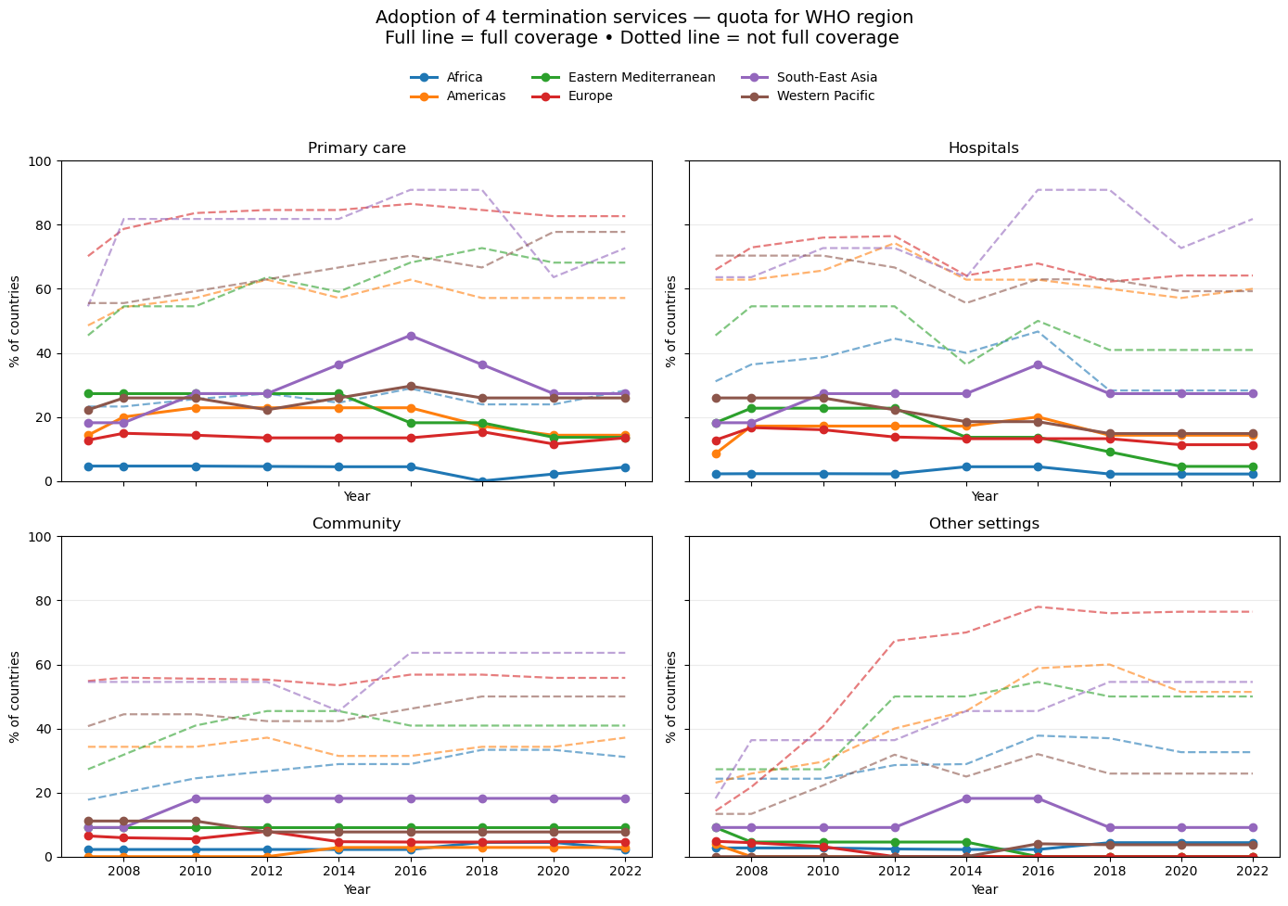
Offering: availability of smoking cessation services in 4 settings for WHO region over the years
In all regions, "any" coverage (dashed) is significantly higher than full coverage (solid line) → implementation gap: many countries have partial initiatives but not yet scaled up to the national level.
Marked growth until the mid-2010s, then plateaus/slight declines in several settings and regions.
Africa remains at low levels in all settings; it is improving slowly, with some recent progress.
Europe and the Western Pacific are generally the regions with the highest percentages (especially in "any" coverage).
Southeast Asia shows peaks around 2016 in several settings, followed by stabilization or slight declines.

Slide 15
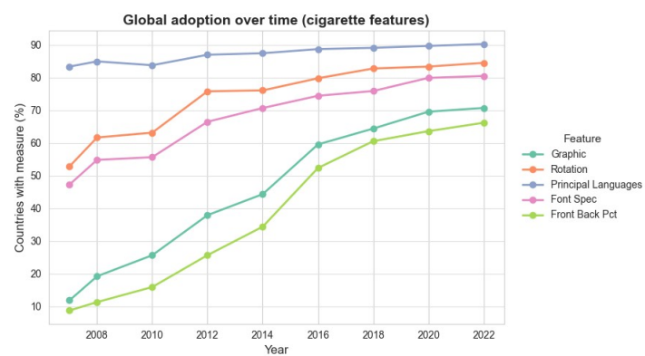
Warning: related features over the years
The features are:
Graphic: warning is graphic/illustrated
Rotation: of text/images, if warning periodically changes to mantain effectiveness
Principal Languages: if warnings are written in the main languages ​​of the country
Font Spec: such as character, dimension, readability…
Front Back Pct: % of surface area covered by notices on the front and back of the package.
Principal languages: high and steady, ~90% in 2022 (near-universal).
Message rotation: ~53% (2007) → ~85% (2022) (+32 %).
Font specifications: ~47% → ~80% (+33 %).
Graphic (pictorial) warnings: sharp rise ~12% → ~70% (+58 %).
Front & Back ≥50% of principal display area: ~9% → ~66% (+57 %), with a clear 2014→2016 step-change.

Slide 16
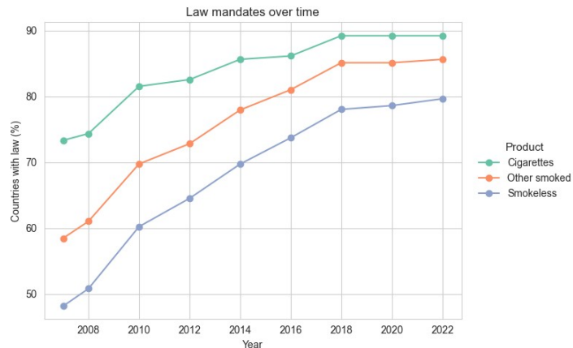
Warning: Countries with a law mandating pack health warnings
Cigarettes: ~73% → ~89%; growth through 2018, then a plateau.
Other smoked (OSM): ~58% → ~86%; steady rise to 2018, then stable.
Smokeless (SML): ~48% → ~80% (+32%), the largest gain but still below smoked products.
SML vs Cigarettes gap: narrows from ~25% (2007) to ~9–10% (2022).

Slide 17
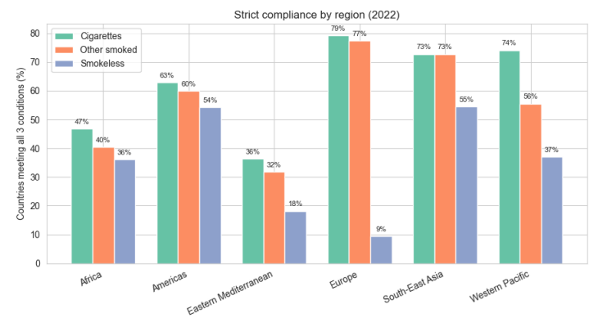
Warning: : % of countries meeting all 3 packaging requirements: law in force, warning on each package, ≥50% front+back coverage.
Europe leads for smoked products: Cigarettes 79%, Other smoked 77%; Smokeless only 9% → large SML gap.
South-East Asia is strong on smoked (73% / 73%) and has the highest SML at 55%.
Americas are solid and balanced: 63% / 60% / 54%.
Western Pacific: Cigarettes 74%, but OSM 56% and SML 37%.
Africa mid-range (47% / 40% / 36%); Eastern Mediterranean lags, especially SML 18%.

Slide 18
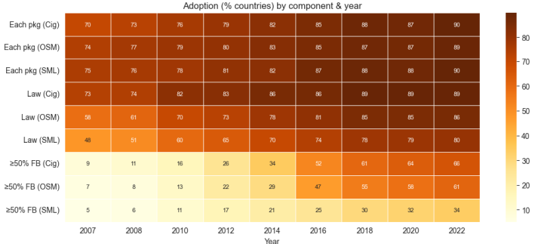
Warning: adoption (% of countries) by component and year (from 2007 to 2022.
Each package: coverage is ~90% in 2022 for cigarettes, other smoked tobacco (OSM), and smokeless tobacco (SML).
Law in force: clear growth; SML rises from 48% (2007) to 80% (2022); OSM ≈ 86% (2022).
50% Front + Back (principal display area): step change in 2014→2016; in 2022 — Cigarettes 66%, OSM 61%, SML 34%.
Takeaway: baseline standards are widespread; stricter ≥50% FB requirements are not yet universal, especially for SML.

Slide 19
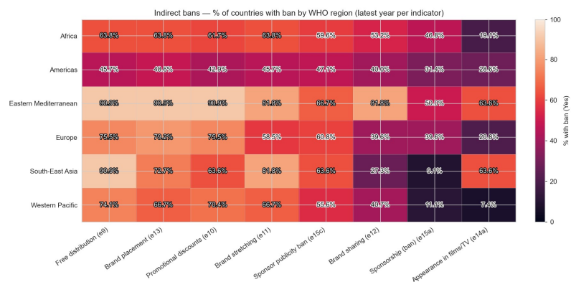
Enforcing: Indirect bans by type
Indicators are: free distribution, promotional discounts, brand placement/stretching/sharing, sponsorship/publicity, appearance in films/TV
Strong variation across items: bans on retail promotions are generally more widespread; brand sharing/extension and films/TV appearances tend to be weaker and uneven.
Regional patterns: some regions show consistent coverage across multiple items, others remain fragmented, especially on media/entertainment and sponsorship.
Displacement risk: weak items become landing zones for marketing activity (e.g., partnerships, placements, audiovisual content).
Policy priorities: broaden definitions (cover digital, influencers, co-branding), add explicit bans on brand sharing/placement, ensure deterrent fines and enforcement tracking.

Slide 20
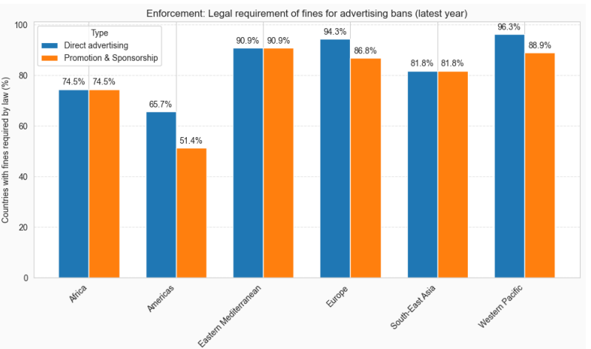
Enforcing: legal requirement of fines for violations (2022)
The legal requirement of fines is widespread but uneven across regions.
Direct advertising is often better covered than P&S, signalling a weak point in TAPS enforcement.
Policy takeaway: align fine requirements across direct and P&S to prevent marketing displacement and ensure consistent bans.

Slide 21
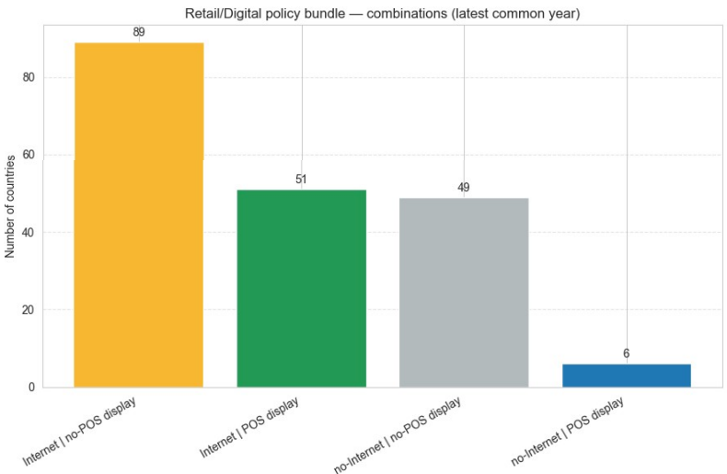
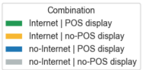
Enforcing: policy bundle - bans on Internet advertising and POS display (1)

Slide 22
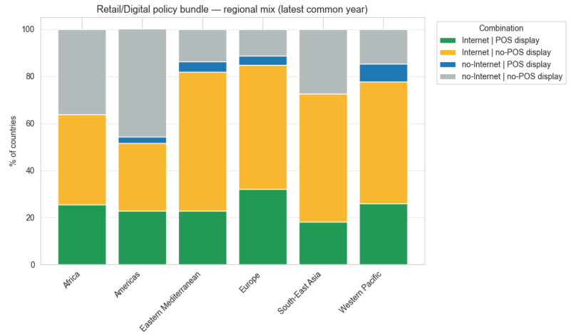
Enforcing: policy bundle - bans on Internet advertising and POS display (2)
The most common bundle is Internet = yes / POS = no → a storefront loophole remains.
Internet = yes / POS = yes is present but not dominant; comparatively stronger in some mature regions (e.g., Europe, Western Pacific).
POS = yes without Internet is rare everywhere.
Several regions still show Internet = no / POS = no, indicating incomplete uptake.
Effectiveness improves when both measures are combined; prioritize closing POS, updating Internet bans (social media, influencers, cross-border ads), and aligning fines/inspections.

Slide 23
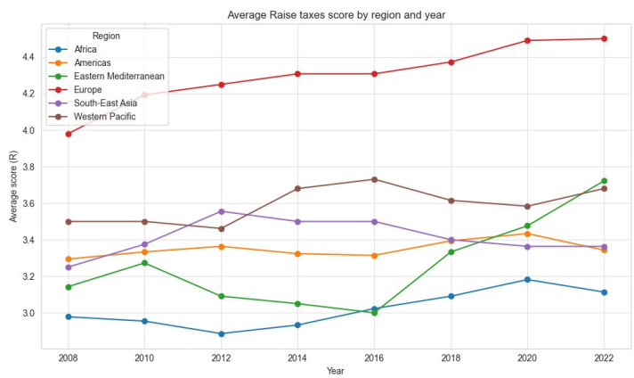
Raising: average score by WHO region over time
Europe is the consistent leader, rising to about 4.5 in 2020–2022 (close to the >75% class).
Western Pacific runs second at ~3.6–3.7: step-up in 2014–2016, slight dip in 2018–2020, uptick in 2022.
South-East Asia remains stable around ~3.4–3.5, with a mild softening after 2018.
Americas are flat near ~3.3–3.4.
Eastern Mediterranean shows a strong catch-up after 2016 (from ~3.0 to ~3.7 by 2022).

Slide 24
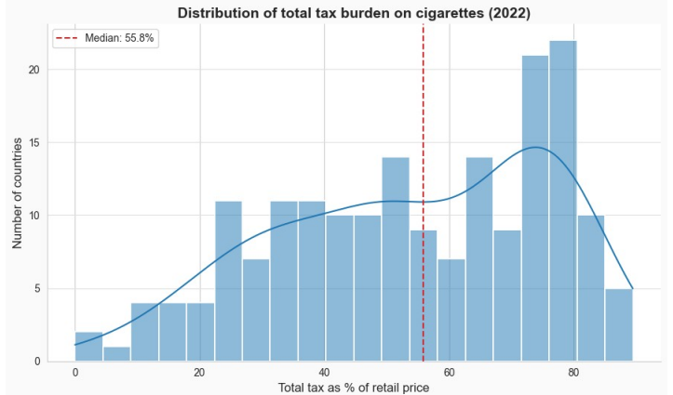
Raising: Distribution of total tax burden on cigarettes (2022)
Global median: 55.8% → below the WHO benchmark ≥75%.
Wide dispersion: many countries at 25–60%, with a noticeable mass around 65–
85%.
Left tail: a few countries <25%, indicating substantial headroom to raise taxes.
Countries at ≥75% remain a minority; scope to increase excise and index
regularly.

Slide 25
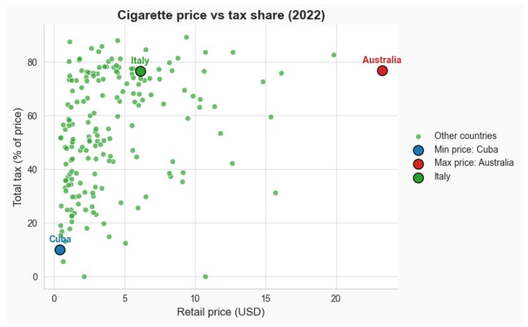
Raising: cigarette price vs tax share (2022)
Overall positive association: higher prices generally pair with higher tax shares, but variance is large.
High outlier: Australia — highest price with tax share >75%.
Low outlier: Cuba — lowest price with very low tax share.
Italy: about $6.1 and ~76.7% taxes — above the WHO benchmark (≥75%).
Differences reflect excise mix (specific vs ad valorem), pre-tax price levels, income, and exchange-rate effects.

Slide 26
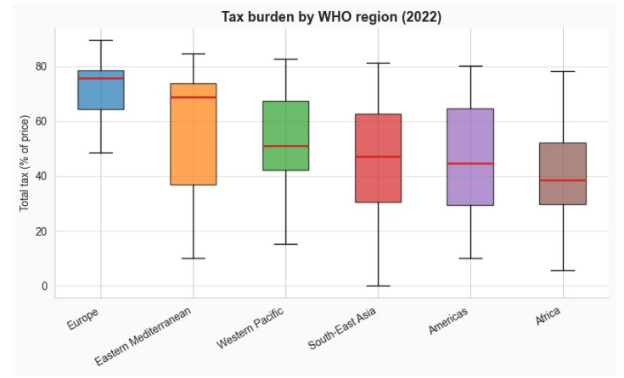
Raising: total tax burden by WHO Region (2022)
Medians (≈): Europe ~77% (highest, near/above ≥75%); Eastern Mediterranean ~68%; Western Pacific ~50%; South-East Asia ~46%; Americas ~44%; Africa ~38%.
Spread: Eastern Mediterranean and South-East Asia show the widest dispersion; Europe is concentrated at higher levels.
WHO benchmark (≥75%): achieved on average only in Europe; elsewhere it’s confined to upper-quartile countries.
Policy signal: substantial room to raise taxes where medians are <50% (Africa, Americas, SE Asia).

Slide 27
Conclusions: Europe, Americas and Western Pacific
Europe
Taxes: Median ≈77%, above the WHO benchmark (≥75%).
Protection: Smoke-free coverage growing to ~40% (2022).
Strong warnings on packages; prevalence still not low.
Western Pacific
Protection: Rising to ~45–46%, then stable from 2018.
Warnings: Good on cigarettes (74%), weaker MDG/SML → inhomogeneity.
Solid but uneven progress across countries.
Americas
Leaders in smoke-free environments: ~75–77% of countries with ≥6/8 locations.
Active enforcement: complaints ~58% (signal of reporting/inspections).
Taxes: median ~44%, room for improvement.

Slide 28
Conclusions: South-East Asia, Africa and East Mediterranean
South-East Asia
Prevalence: sharp decline (≈30% → 17%).
Warnings and packaging: solid on smokers; SML fair.
Cessation services in primary care declining; smoke-free ~27–28% stagnant.
Eastern Mediterranean
Protection: rapid growth until ~2013–15, then plateaued at ~40%.
Taxes: sharp recovery (score ≈3.7 in 2022).
Packaging: weak on SML (≈18% with all 3 requirements).
Africa
Protection: From ~0 (2007) to ~35–36% (2022).
Cessation provision and integration in settings: very low but growing.
Taxes: median ~38% → significant room for improvement.

Slide 29
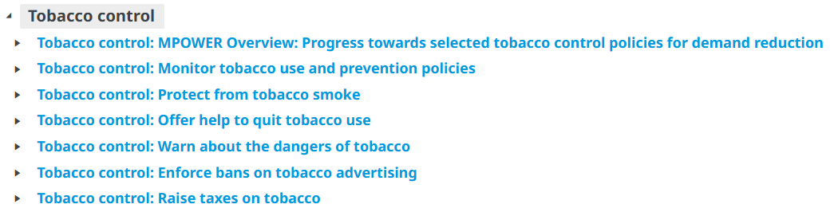
Data sources
https://www.who.int/data/gho/data/indicators

Slide 30
Thanks for your attention!
Marco Colangelo 67045A
Pablo Fabricio Aguirre Guaman 67074A

